Slide 1

HR Analytics Employee Dashboard
Insights into Workforce Metrics and Trends
Presented by:
SANJAN PANDIT
YASH MALI
DIYA GOTECHA
Notes:
https://unsplash.com/photos/assorted-title-book-lot-on-shelf-_OZCl4XcpRw

Slide 2



Introduction
Purpose: Provide a comprehensive view of key HR metrics.
Key Insights: Employee performance, attrition trends, diversity, and engagement.
Overview of Dashboard
Visualizations: Cards, charts
Visualizations : slicers for detailed analysis
Notes:
https://unsplash.com/photos/man-in-blue-scrub-suit-standing-near-white-and-black-office-rolling-chair-UNkNx6Hn9Fs

Slide 3


Card Visualizations
Card 1
Total Monthly Salary – Displays overall salary distributed.
Card 2
Average Salary – Highlights mean income.
Dashboard Cards
Total Employees – Shows workforce count.
Card 3
Card 4
Attrition Rate – Indicates employee turnover percentage.
Card 5
.
Average Tenure – Reflects company tenure of employees.
Notes:
https://unsplash.com/photos/man-in-blue-scrub-suit-standing-near-white-and-black-office-rolling-chair-UNkNx6Hn9Fs

Slide 4
Slicer Visualizations
Slicers are interactive filters that allow users to refine data views based on specific criteria, enhancing analysis and decision-making.
Slicer 1: Filter data based on Gender, allowing analysis of male and female workforce distribution.
Slicer 2: Filter data based on Attrition Status to identify trends in employee turnover.
Dashboard Slicers
Slicer 3: Filter data based on Age Group, categorizing employees into relevant age brackets.
Slicer 4: Filter data based on Job Role to explore role-specific metrics and trends.
Notes:
https://unsplash.com/photos/man-in-blue-scrub-suit-standing-near-white-and-black-office-rolling-chair-UNkNx6Hn9Fs

Slide 5
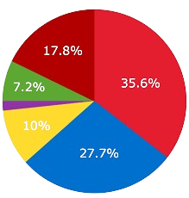

Pie Charts
Pie charts are circular graphs divided into slices to represent proportions. In this case, they visually display the distribution of employees by gender and marital status, offering a clear overview of these demographics within the organization.
Employee Distribution by Gender
Employee Distribution by Marital Status
Male Employees: The percentage of male employees.
01
Single Employees: The percentage of employees who are unmarried.
01
Dashboard pie charts
Female Employees: The percentage of female employees.
02
Data
Collection
Married Employees: The percentage of employees who are married.
02
Non-binary Employees: Any employees who identify as non-binary..
03
Divorced Employees: The percentage of employees who are divorced or separated.
03
Gender Ratio: A visual representation male and female employees.
04
Widowed Employees: The percentage of employees who are widowed
04
Notes:
https://unsplash.com/photos/man-in-blue-scrub-suit-standing-near-white-and-black-office-rolling-chair-UNkNx6Hn9Fs

Slide 6
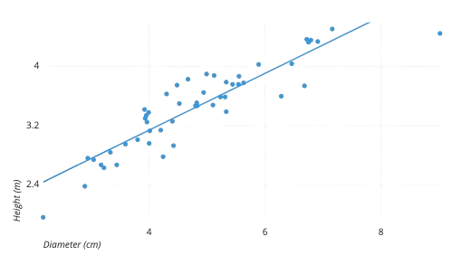
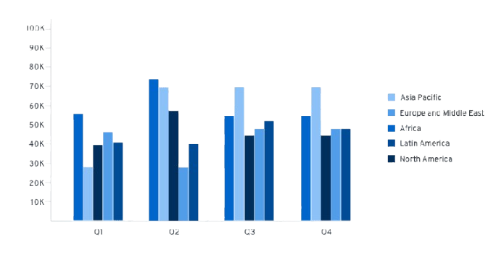


Bar and Scatter Charts
Scatter Chart:
Stacked Column Chart
Analyzes relationship between Company Tenure and Distance from Work.
Displays employee distribution across Age Groups.
The Stacked Column Chart shows employee distribution by age groups. The Scatter Chart examines the relationship between company tenure and distance from work.
Notes:
https://unsplash.com/photos/man-in-blue-scrub-suit-standing-near-white-and-black-office-rolling-chair-UNkNx6Hn9Fs

Slide 7

Job Satisfaction and Role Analysis
Tree Map: Visualizes job satisfaction and work-life balance metrics with nested rectangles.
Funnel Chart: Shows employee distribution across job roles in a narrowing format.
Tree Map:
Highlights Job Satisfaction and Work-Life Balance metrics.
80%
Funnel Chart:
Shows distribution of employees across Job Roles.
50%
Notes:
https://unsplash.com/photos/man-in-blue-scrub-suit-standing-near-white-and-black-office-rolling-chair-UNkNx6Hn9Fs

Slide 8
Age and Attrition Trends
Line Chart: Age Group vs. Attrition Trends.
Scatter Plot: Attrition vs. Overtime Comparison.
Line Chart: A chart that shows the relationship between age groups and attrition over time, highlighting trends.
Scatter Plot: A chart that compares attrition and overtime metrics, displaying data points to identify patterns or correlations
Notes:
https://unsplash.com/photos/man-in-blue-scrub-suit-standing-near-white-and-black-office-rolling-chair-UNkNx6Hn9Fs

Slide 9
Department and Leadership Analysis
Stacked Column Chart: Displays job levels, roles, and the number of departments in the organization. Clustered Column Charts: Analyze remote work, work-life balance, job satisfaction, and leadership opportunities across different employee categories.
70%
60%
50%
Stacked Column Chart
Clustered Column Chart 1:
Clustered Column Chart 2:
Shows Job Levels, Job Roles, and Number of Departments.
Analyzes Remote Work and Work-Life Balance.
Highlights Job Satisfaction and Leadership Opportunities.
Notes:
https://unsplash.com/photos/man-in-blue-scrub-suit-standing-near-white-and-black-office-rolling-chair-UNkNx6Hn9Fs

Slide 10
Diversity and Remote Work Insights
Pie Chart 1: Displays the distribution of employees participating in remote work. Pie Chart 2: Shows the distribution of employees based on their education levels. Key Insight: Technology has the highest employee count; focus on enhancing diversity in
Finance and Media sectors.
35%
Pie Chart 1
40%
Pie Chart 2
60%
Key Insight:
Distribution of Remote Work participation.
Employee Education Levels.
Technology has the highest employees; focus on Finance and Media to improve diversity.
Notes:
https://unsplash.com/photos/man-in-blue-scrub-suit-standing-near-white-and-black-office-rolling-chair-UNkNx6Hn9Fs

Slide 11
Recommendations and Key Concerns
Remote Work: Offer flexible options to improve satisfaction and productivity.
.
Work-Life Balance: Enhance engagement for employees in the "Low" satisfaction category.
Younger Workforce: Introduce mentorship and career development programs.
Gender diversity efforts could aim to better balance male and female representation in leadership and other roles.
High Attrition Rate (90.65%): Requires urgent attention. Analyze reasons for leaving to improve retention.

Slide 12



Conclusion
Summary: The dashboard delivers key data to inform HR strategies and decision- making.
Next Steps: Develop and execute plans to tackle issues related to attrition, diversity, and employee satisfaction.
Summary: The dashboard provides actionable insights for HR decision-making.
Next Steps: Implement strategies to address attrition, diversity, and employee satisfaction.
Notes:
You can safely remove this slide. This slide design was provided by SlideModel.com – You can download more templates, shapes and elements for PowerPoint from http://slidemodel.com/

Slide 13

Notes:
You can safely remove this slide. This slide design was provided by SlideModel.com – You can download more templates, shapes and elements for PowerPoint from http://slidemodel.com

